Slide 1

A Genetic Approach to the Ethical Knob
Giovanni IACCA (University of Trento)
Francesca LAGIOIA (EUI/CIRSFID)
Andrea LOREGGIA (EUI)
Giovanni SARTOR (EUI/CIRSFID)

Slide 2
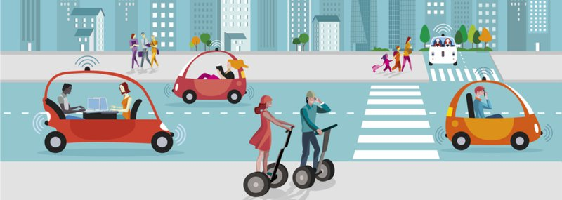
Autonomous vehicles

Slide 3
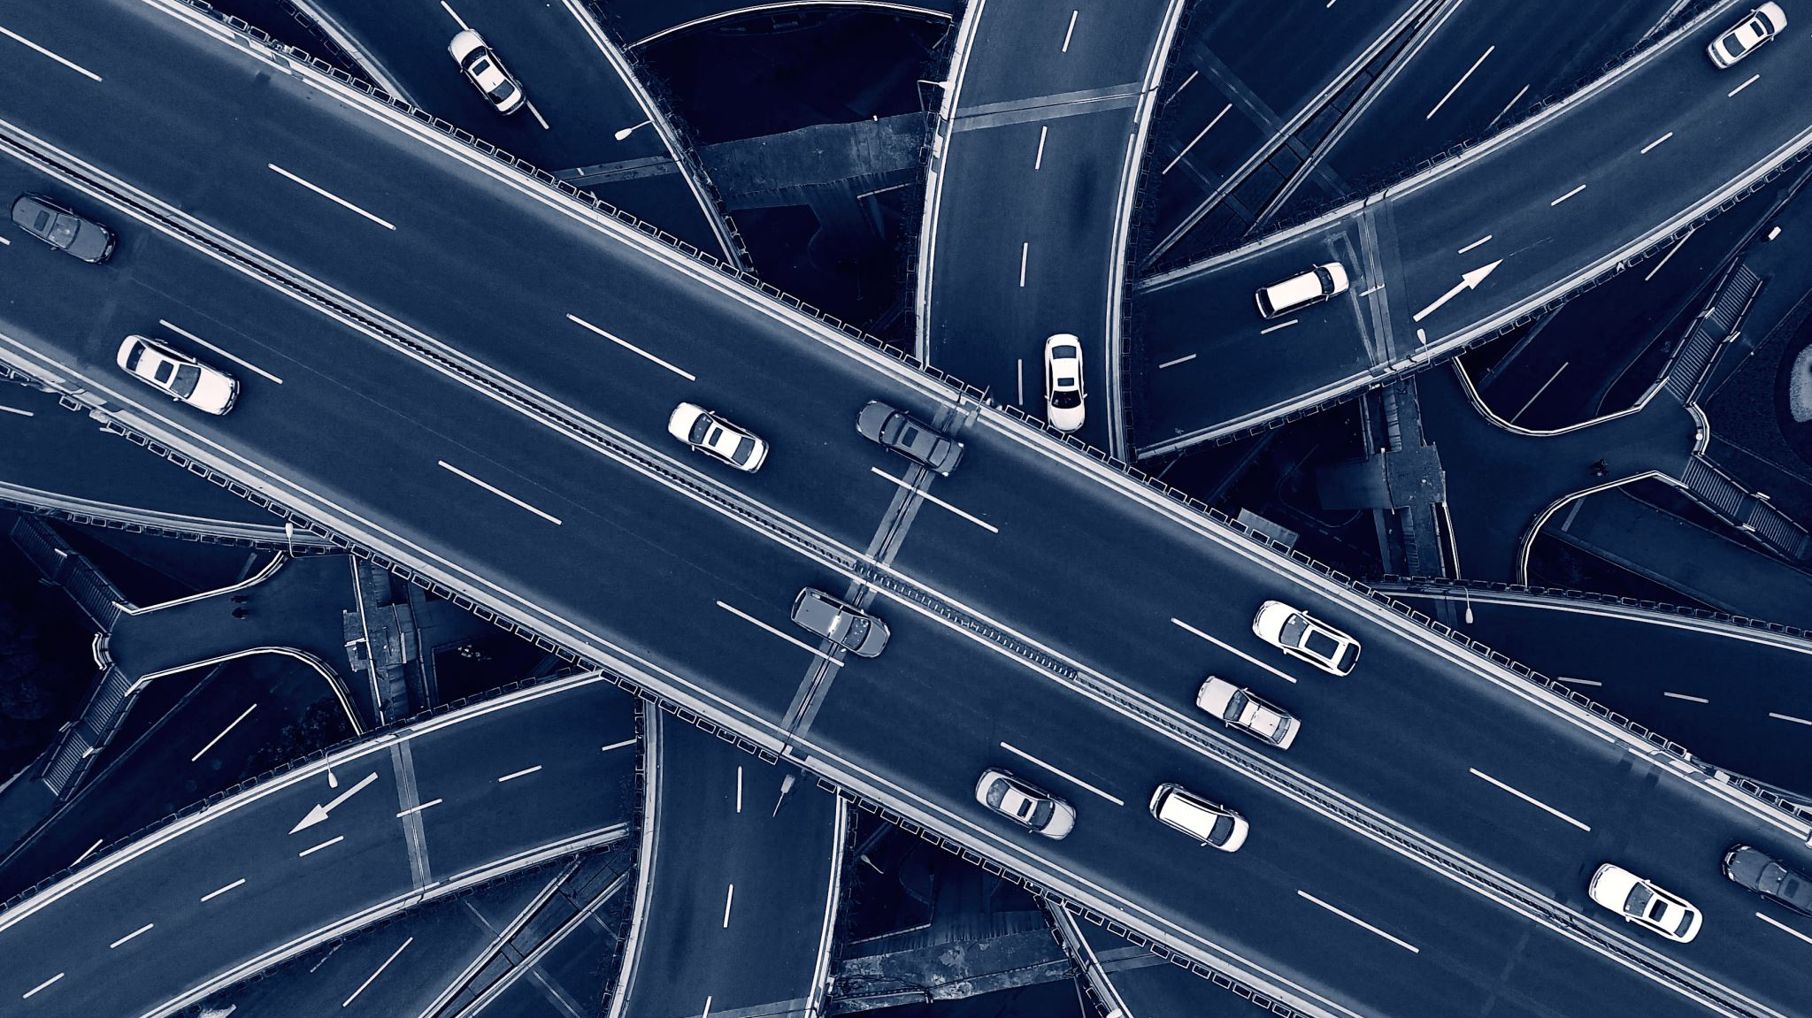
Autonomous vehicles
Autonomous Driving is classified according to the amount of human driver intervention:
From Level 0 (no automation) to Level 5 (full automation)

Slide 4
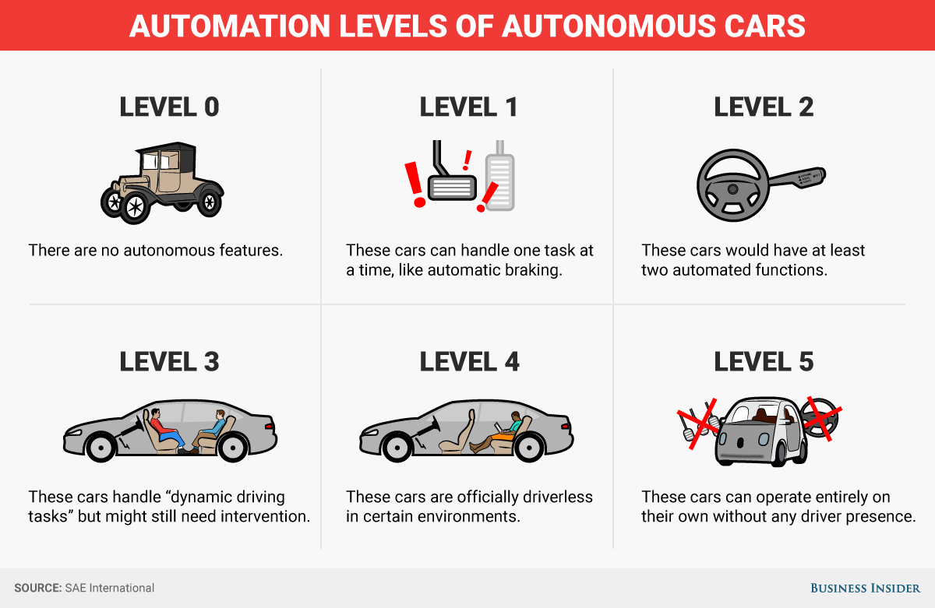
Autonomous vehicles

Slide 5
Autonomous vehicles
The amount of data to process increase with the level of automation
4.4 GB/s Data Logging for full Autonomous Driving

Slide 6
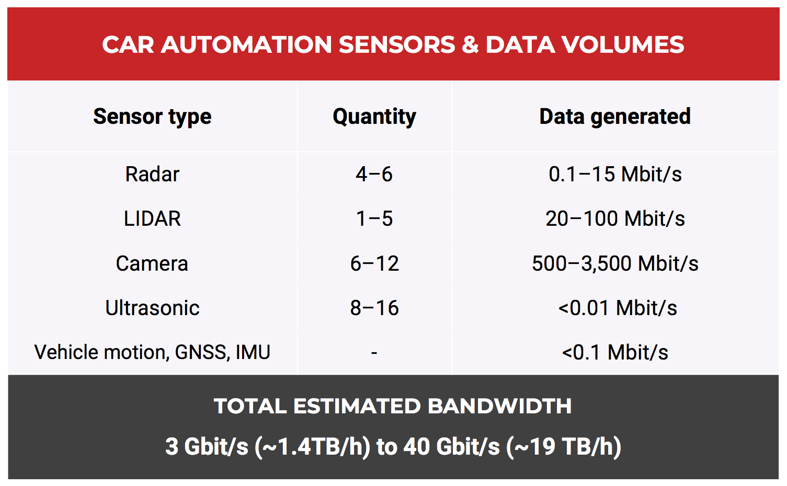
Autonomous vehicles

Slide 7
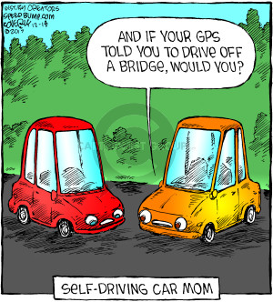
Autonomous vehicles can potentially FAil

Slide 8
outline
Introduction
Ethical knob, individual preferences and social values
Genetic Algorithms
Neural Networks
Genetic Approach to the Ethical Knob
Conclusion/Discussion

Slide 9
The moral decisions

Slide 10
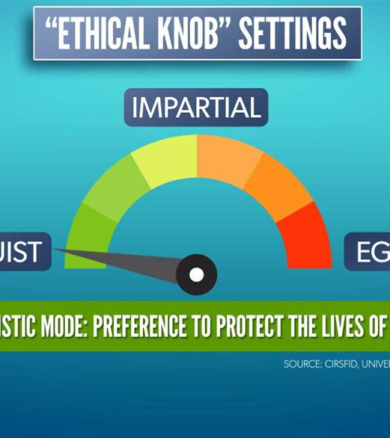
The orig. proposal
The knob expresses directly the ethical attitude of the AV passengers
The value passengers attribute to their life relative to the value of the lives of third parties

Slide 11
The new proposal
The position of the knob no longer indicates the passengers’ moral attitude
It indicates the AV’s assessment of the relative importance of the lives of passenger(s) and third parties

Slide 12
HOW to do that?
Combination of AI techniques:
Neural networks to compute the right action to take based on the given scenario
Genetic Algorithm to find an (almost) optimal configuration of neural networks

Slide 13
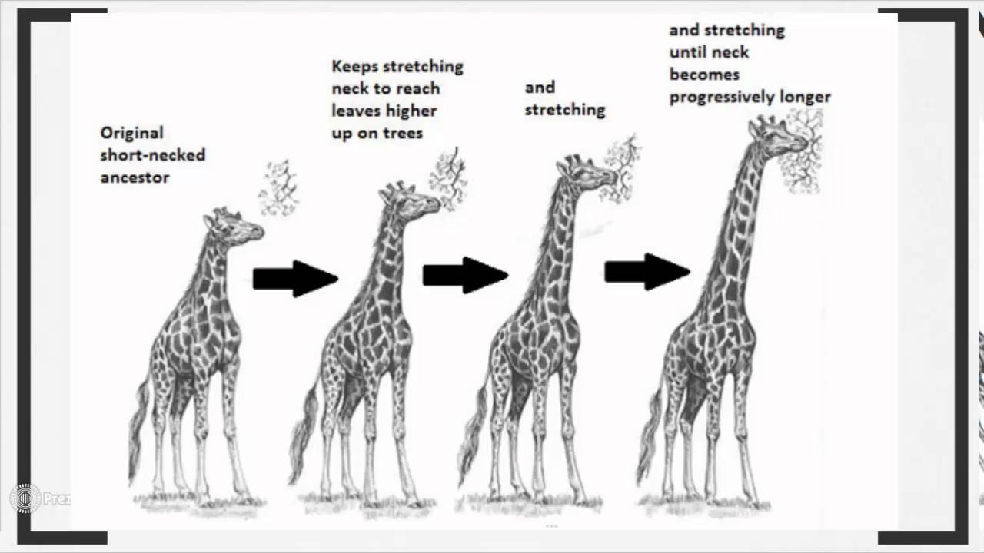
The evolutionary theory

Slide 14
Genetic algorithms
Inspired by Charles Darwin’s theory of natural evolution:
the fittest individuals are selected for reproduction in order to produce offspring of the next generation
Heuristic Search in the solution space
Mostly used in optimization tasks

Slide 15
Genetic algorithms
It is of main importance to:
Identify a clear representation of a solution
Define a fitness function which represents the value of a solution

Slide 16
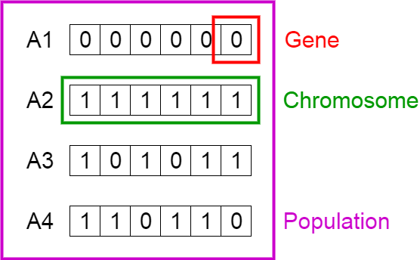
Genetic algorithms

Slide 17
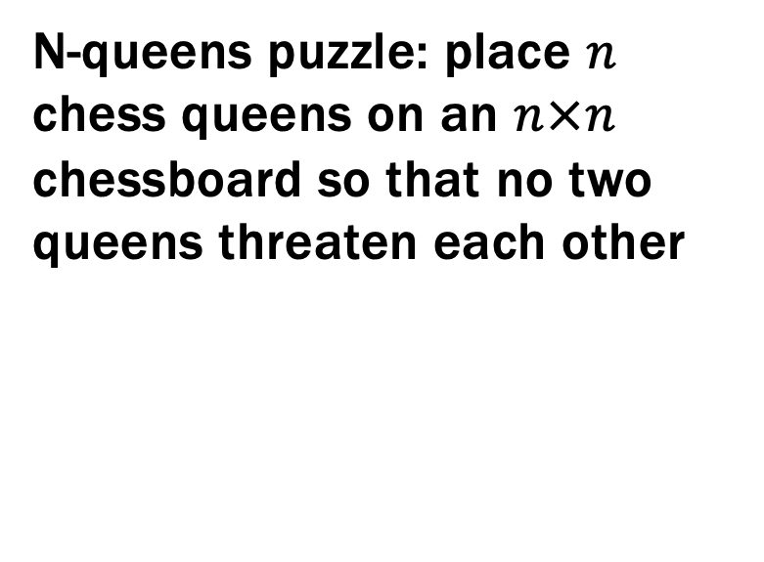
Simple example
N-queens puzzle: place $n$ chess queens on an $n×n$ chessboard so that no two queens threaten each other

Slide 18
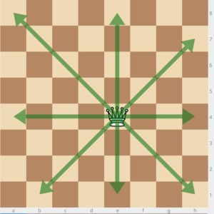
Simple example

Slide 19
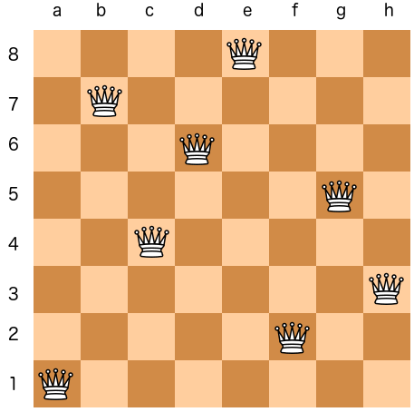
Simple example

Slide 20
Simple example
Possible solution
1 | 7 | 4 | 6 | 8 | 2 | 5 | 3

Slide 21
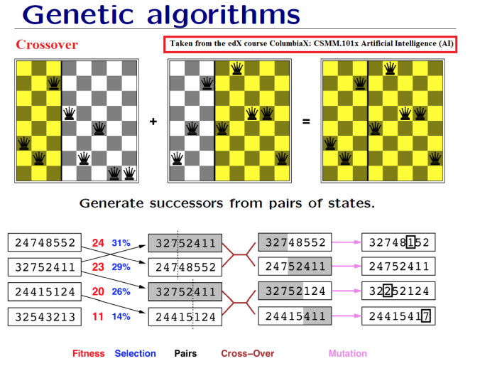
How it works
Individuals corresponds to solutions of the problem
Initially, solutions are generated at random
Each individual is evaluated
Best individuals are selected and used to be combined and produce a new generation

Slide 22
How it works
Individuals corresponds to solutions of the problem
Initially, solutions are generated at random
Each individual is evaluated
Best individuals are selected and used to be combined and produce a new generation
3 | 2 | 7 | 5 | 2 | 4 | 1 | 1
2 | 3 | 7 | 3 | 8 | 5 | 5 | 2
3 | 2 | 7 | 3 | 8 | 5 | 5 | 2

Slide 23
How it works

Slide 24
How it works
Keep iterating until:
Optimal solution is found
A maximum number of iteration is reached
3 | 2 | 7 | 5 | 2 | 4 | 1 | 1
2 | 3 | 7 | 3 | 8 | 5 | 5 | 2
3 | 2 | 7 | 3 | 8 | 5 | 5 | 2

Slide 25
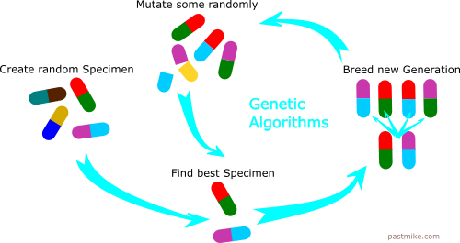
Genetic algorithms

Slide 26

Artificial Neural Network
Inspired by natural neural network
Classification / Regression
Adaptive Model, the internal state is adjusted during the training phase

Slide 27
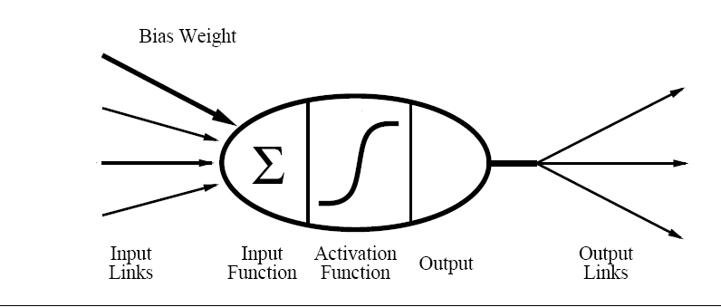
Artificial Neural Network: Origins
Formal model of a neuron:
McCulloch, W. S. and Pitts, W. (1943). A logical calculus of the ideas immanent in nervous activity. Bulletin of Mathematical Biophysics, 5, 115–137.

Slide 28
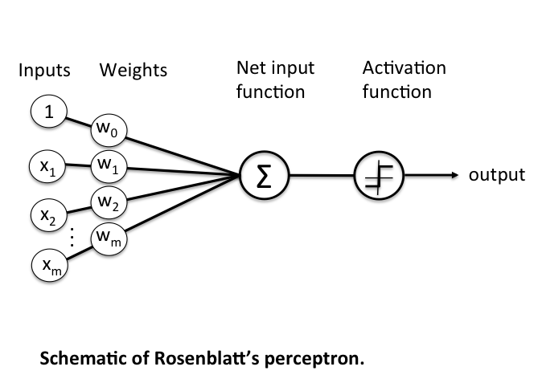
Artificial Neural Network: Origins
Based on perceptron (binary classifier):
Input values are weighted based on "importance"
Weighted input are summed up
The sum is transformed using an activation function
Rosenblatt, Frank. Principles of neurodynamics. perceptrons and the theory of brain mechanisms.
No. VG-1196-G-8. Cornell Aeronautical Lab Inc Buffalo NY, 1961.

Slide 29
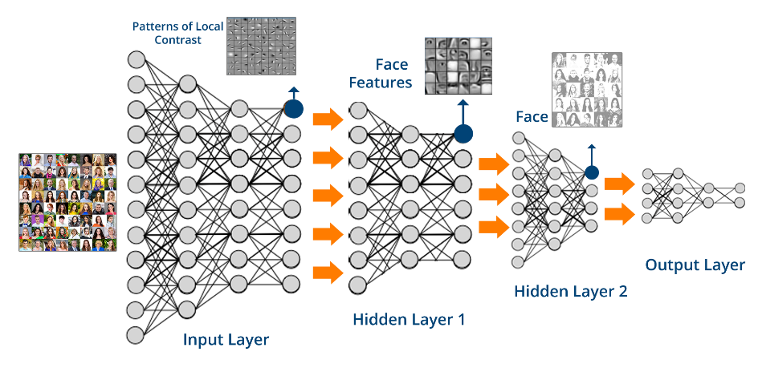
Artificial Neural Network
Neural network are made of several layers of perceptron, the main idea is to mimic the cerebral cortex

Slide 30

Artificial Neural Network
Neural network are made of several layers of perceptron, the main idea is to mimic the cerebral cortex

Slide 31
Artificial Neural Network: Backpropagation
The network is trained based on sample pairs (x,y) (training set).
The training set is used several times (each time is called an epoch), weights are adjusted in order to decrease the error.
Gradient descent is efficient, but it can stuck in a local minimum.
Training is in general NP-Complete.
Initialize weights at random
repeat
for each example in the training set
compute example’s output
compute quadratic error
for i = levels_# down to 1
compute update for weights at level i
end
update all weights
end
until (all examples correctly classified or max iterations reached)
Werbos (1974). Beyond Regression: New Tools for Prediction and Analysis in the Behavioral Sciences. Ph.D. Thesis, Harvard University.
Rumelhart, Hintont, Williams (1986). Learning representations by back-propagating errors. Nature

Slide 32
Gradient Descent
The idea is computing the partial derivative of the error function in order to reduce the loss.

Slide 33
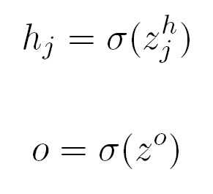
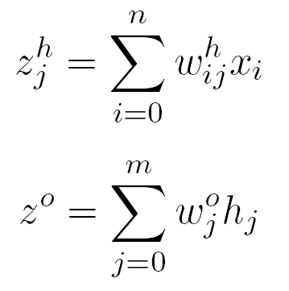
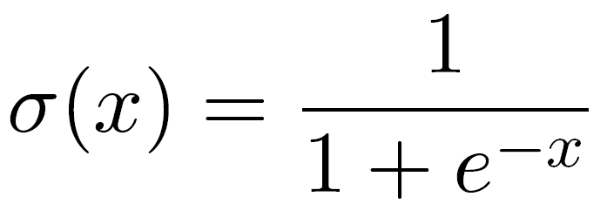
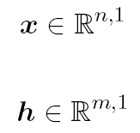
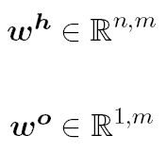
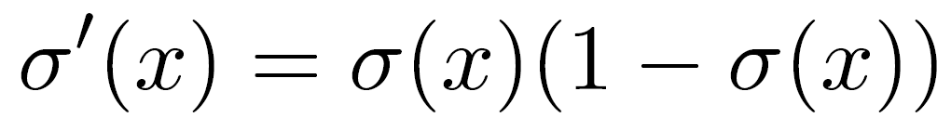
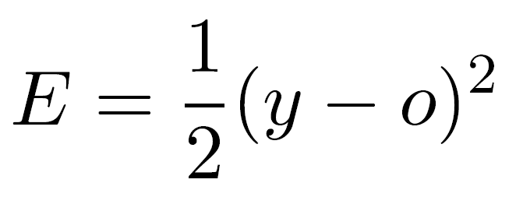
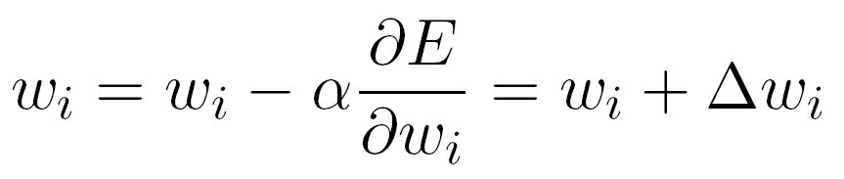
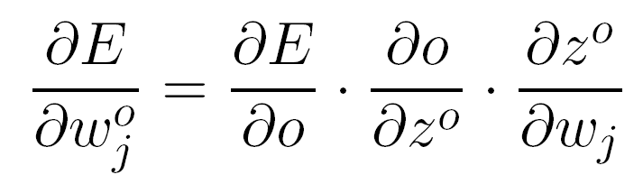
Artificial Neural Network: Backpropagation
Definitions:
Activation Function:
Error function:

Slide 34
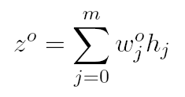
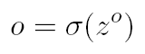
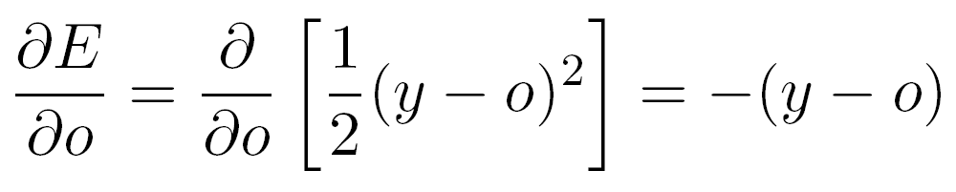
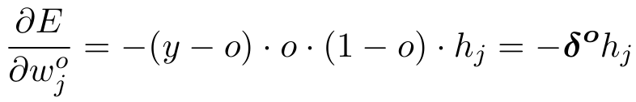
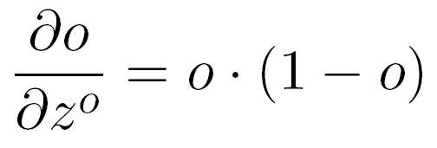
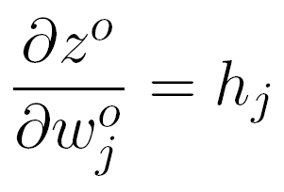
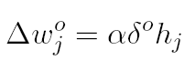
Artificial Neural Network: Backpropagation
Weight update:

Slide 35
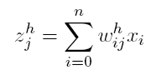
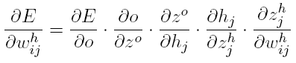
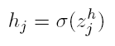
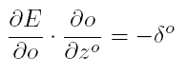
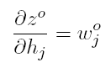
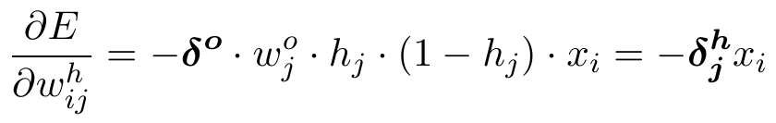
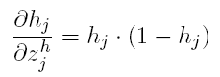
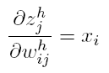
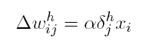
Artificial Neural Network: Backpropagation
Weight update:

Slide 36
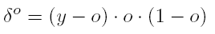
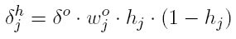
Artificial Neural Network: Backpropagation
Weights update:
with
Learning rate

Slide 37
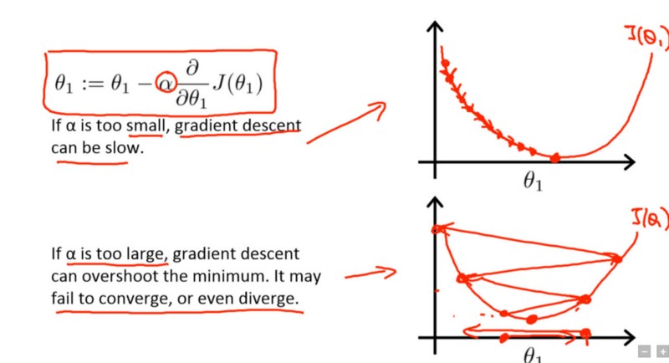
Gradient descent
Andrew Ng’s course on Coursera

Slide 38
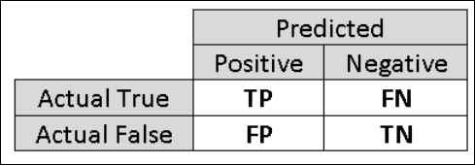
Performance
Confusion matrix shows how many true/false positives and true/false negatives

Slide 39

Performance
Accuracy
$$\frac{(TP+TN)}{n}$$
Precision and Recall
F1 Score o F-score, weighted sum of Precision and Recall
$$2×\frac{P×R}{P+R}$$
K of Cohen

Slide 40
Genetic approach to ek: why?
We cannot use gradient descent:
What data?
How to train?
Which values for hyper-parameters?
Where? In which scenarios?

Slide 41
HOW to do that?
Combination of AI techniques:
Neural networks to compute the right action to take based on the given scenario
Genetic Algorithm to find an (almost) optimal configuration of neural networks

Slide 42
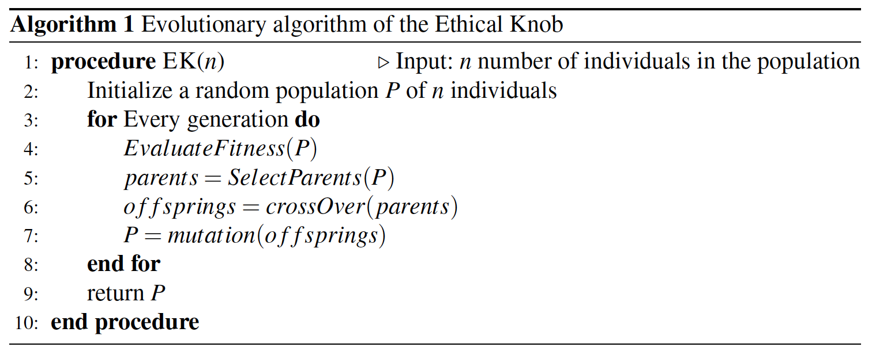
Genetic approach to ek

Slide 43
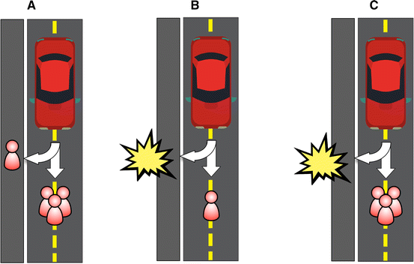
Simulation
An individual in the simulation corresponds to an AV

Slide 44
Simulation: population
We represent an AV using a NN. The NN:
Analyzes the scenario
Outputs the level of the knob
The knob value is used to take an action

Slide 45
Simulation: population
Any scenario has:
Altruism level
Number of passengers
Prob. of harming passengers
Number of pedestrians
Prob. of harming pedestrians
Population

Slide 46
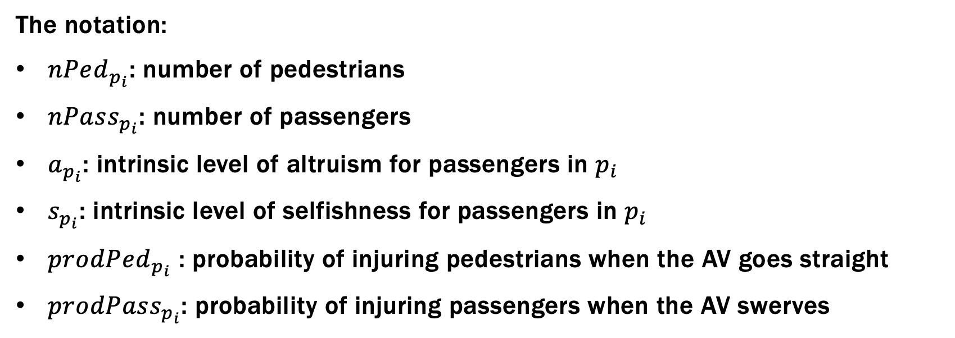
Simulation: evaluation
The notation:
$nPed_{p_{i}}$: number of pedestrians
$nPass_{p_{i}}$: number of passengers
$a_{p_{i}}$: intrinsic level of altruism for passengers in $p_{i}$
$s_{p_{i}}$: intrinsic level of selfishness for passengers in $p_{i}$
$prodPed_{p_{i}}$ : probability of injuring pedestrians when the AV goes straight
$prodPass_{p_{i}}$: probability of injuring passengers when the AV swerves

Slide 47
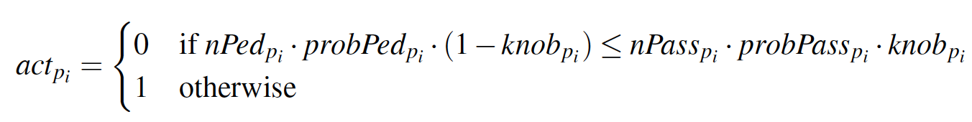
Simulation: evaluation
The action is taken based on the assessment computed by the NN. The idea is pondering which action minimize harm with respect to relative importance of lives:
Go straight
Swerve otherwise

Slide 48
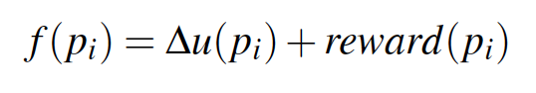

Simulation: evaluation
Individual is evaluated using the following fitness function:
The social evaluation of the individual behaviour.
Reward/punishment based on action taken by the average individual
Fitness of $p_{i}$
Difference between the utility of the choice made and the expected utility of the alternative choice

Slide 49
Simulation: evaluation
Utility for the taken action
Expected utility for the alternative choice

Slide 50


Simulation: evaluation
Depending on the taken action, the utility is computed based on the response of the scenario:
where ${dead}_{p_{i}}$ is 0 if people survived, 1 otherwise.

Slide 51
Simulation: evaluation
Selfish utility preserving passengers
Total legal sanction (compensation) due for causing
the death of a pedestrian
Altruistic utility obtained by preserving pedestrians

Slide 52

Simulation: evaluation
The second component is computed based on the alternative action:
Notice that single components are weighted using the likelihood of harming pedestrian/passengers in this case.

Slide 53
Simulation: evaluation
The reward depends on whether the AV’s behaviour differs from the average behaviour of the community:
If the average individual would go straight and the AV turns, then the action is rewarded (having done an action that is meritorious, since it minimizes the risk of losses more than the average)
On the other hand, if the average individual would turn and the AV goes straight, then it is punished.

Slide 54

Simulation: evaluation
The reward depends on whether the AV’s behaviour differs from the average behaviour of the community:

Slide 55

Simulation: selection
Tournament selection: individuals are randomly
paired. For each couple, the individual with the
highest fitness is selected for reproduction.
Icons made by Freepik from https://www.flaticon.com/

Slide 56
Simulation: crossover
Mimicking the combination of genes that takes part in reproduction
Chromosomes are represented by the weights of NN
New chromosome by choosing at random one weight from one parent or the other.
Icons made by Freepik from https://www.flaticon.com/

Slide 57
Simulation: mutation
It is applied to each child’s chromosomes
Alters certain genes with some probability
It is used to prevent premature convergence
Icons made by Freepik from https://www.flaticon.com/

Slide 58

Empirical evaluation
Experiment 1: $reward(pi) = 0$and $cPed = 0$. The aim is to test a simple situation in which the fitness function does not take into account any penalties from legal norms or any reward/stigma deriving from social norms.
Experiment 2: $reward(pi) = 0$and $cPed = 1$. The aim is to check whether legal norms may influence the system’s performance.
Experiment 3: the reward is in $\{−0.25;0.25\}$ and $cPed = 0$. The aim is to explore whether social norms may influence the system’s performance.
Experiment 4: the reward is in $\{−0.25;0.25\}$ and $cPed = 1$. The aim is to check whether and to what extent the combination of legal and social norms may influence the system’s performance.

Slide 59
Empirical evaluation
The prediction task can be seen as a binary classification task in which the AV learns to take the action which maximizes the payoff. In particular, looking at the fitness function, we classify samples as:
Real Positive: the preferable action is to turn;
Real Negative: the preferable action is to go straight;
Predicted Positive: the neural network predicts a knob level which makes the AV turn;
Predicted Negative: the neural network predicts a knob level which makes the AV go straight.

Slide 60
Empirical evaluation
Three different metrics:
Accuracy, which describes how many predictions coincide with the preferable actions;
Confusion Matrix, which shows true positives, true negatives, false positives and false negatives;
Number of victims, which describes the number of casualties that may be caused by an AV, using the knob values proposed by neural networks. In particular, the last metric is compared with number of victims caused by 3 different AVs: one which always minimizes the number of victims, one which always chooses the optimal action and one which always maximizes the number of victims.

Slide 61
Empirical evaluation

Slide 62


Empirical evaluation

Slide 63
Empirical evaluation
Number of victims

Slide 64
Empirical evaluation
Number of victims

Slide 65
conclusion/discussion
What importance to give to the safety of passengers relative to the safety of pedestrians
The assessment of the value of the AV’s choices is dependant on considering the passengers’ moral attitude (their intrinsic preferences) as well as legal sanctions and social norms (extrinsic incentives)
Convergence of socially valuable behaviour can be obtained by providing appropriate mechanisms for sanction and reward

Slide 66
conclusion/discussion
We aim to expand our model, for instance:
Agents with memory
Enabling agents to learn probability distributions
Considering their past outcomes and those of observable others
Adapting their ethical approach to societal preferences.

Slide 67

conclusion/discussion
We also plan to insert out agents in existing traffic simulators (such as SUMO) to test our model in a dynamic environment.

